Slide 1
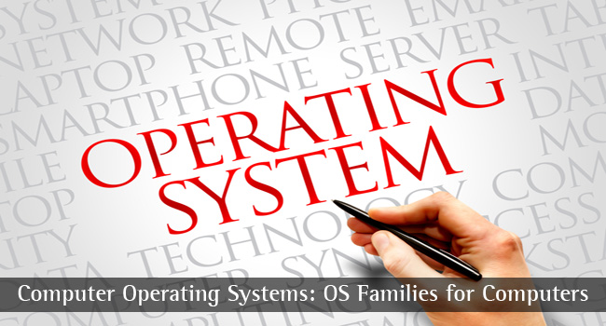
CS-3103 : Operating Systems : Sec-A (NB) :
Protection & Security…..
Operating System Concepts

Slide 2
Protection
A computer system is a collection of processes and objects. By objects, we mean both hardware objects (such as, CPU, memory segments, printers, disks, tape drives) and software objects (such as files, programs, semaphores).
Each object has a unique name that differentiates it from all other objects in the system, and each can be accessed only through well-defined and meaningful operations.
The operations that are possible may depend on the object. Example: on a CPU, we can only execute. Memory segments can be read and written, whereas a CD-ROM or DVD-ROM can only be read. Tape drives can be read, written, and rewound. Data files can be created, opened, read, written, closed, and deleted; program files can be read, written, executed, and deleted.
Operating System Concepts

Slide 3
Goals of Protection
Obviously to prevent malicious misuse of the system by users or programs. See chapter 15 for a more thorough coverage of this goal.
To ensure that each shared resource is used only in accordance with system policies, which may be set either by system designers or by system administrators.
To ensure that errant programs cause the minimal amount of damage possible.
Note that protection systems only provide the mechanisms for enforcing policies and ensuring reliable systems. It is up to administrators and users to implement those mechanisms effectively.
Operating System Concepts

Slide 4
Principles of Protection
The principle of least privilege dictates that programs, users, and systems be given just enough privileges to perform their tasks.
This ensures that failures do the least amount of harm and allow the least of harm to be done.
For example, if a program needs special privileges to perform a task, it is better to make it a SGID program with group ownership of "network" or "backup" or some other pseudo group, rather than SUID with root ownership. This limits the amount of damage that can occur if something goes wrong.
Typically each user is given their own account, and has only enough privilege to modify their own files.
The root account should not be used for normal day to day activities - The System Administrator should also have an ordinary account, and reserve use of the root account for only those tasks which need the root privileges
Operating System Concepts

Slide 5
The Security Problem
The Security Problem
Authentication
Program Threats
System Threats
Threat Monitoring
Encryption
Security must consider external environment of the system, and protect it from:
  unauthorized access.
  malicious modification or destruction
  accidental introduction of inconsistency.
Easier to protect against accidental than malicious misuse.
Operating System Concepts

Slide 6
What does Operating System Security (OS Security) mean?
Operating system security (OS security) is the process of ensuring OS integrity, confidentiality and availability.
OS security refers to specified steps or measures used to protect the OS from threats, viruses, worms, malware or remote hacker intrusions. OS security encompasses all preventive-control techniques, which safeguard any computer assets capable of being stolen, edited or deleted if OS security is compromised.
What is operating system security?
How do operating systems contribute to
system security?
Alternatively, if we’re trying to develop a secure system, what do we demand from the OS?
Operating System Concepts

Slide 7
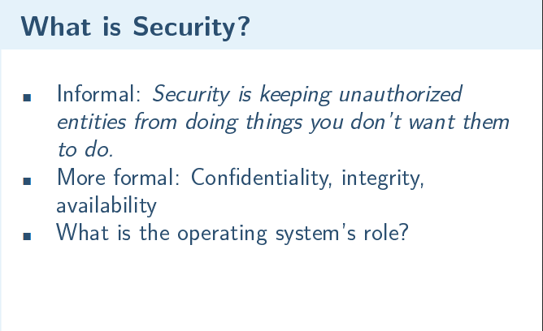
Operating System Concepts

Slide 8
Authentication
User identity most often established through passwords, can be considered a special case of either keys or capabilities.
Passwords must be kept secret.
  Frequent change of passwords.
  Use of “non-guessable” passwords.
  Log all invalid access attempts.
Operating System Concepts

Slide 9
Program Threats
Trojan Horse
  Code segment that misuses its environment.
  Exploits mechanisms for allowing programs written by users to be executed by other users.
Trap Door
  Specific user identifier or password that circumvents normal security procedures.
  Could be included in a compiler.
Operating System Concepts

Slide 10
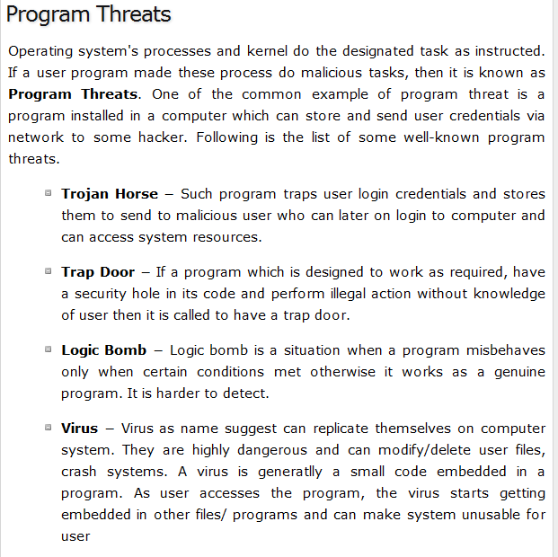
Operating System Concepts

Slide 11
System Threats
Worms – use spawn mechanism; standalone program
Internet worm
  Exploited UNIX networking features (remote access) and bugs in finger and sendmail programs.
  Grappling hook program uploaded main worm program.
Viruses – fragment of code embedded in a legitimate program.
  Mainly effect microcomputer systems.
  Downloading viral programs from public bulletin boards or exchanging floppy disks containing an infection.
  Safe computing.
Operating System Concepts

Slide 12
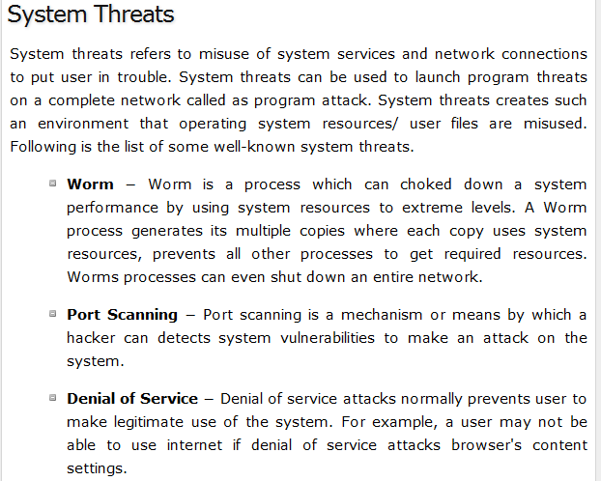
Operating System Concepts

Slide 13
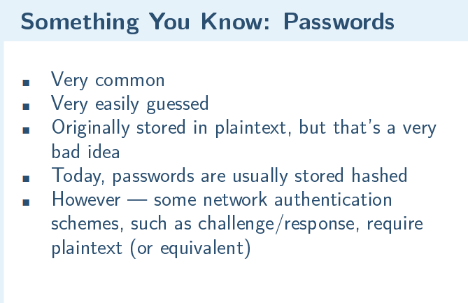
Operating System Concepts

Slide 14
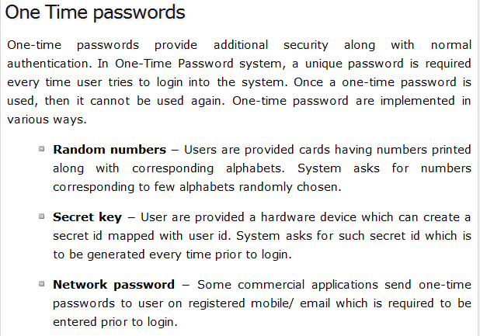
Operating System Concepts

Slide 15
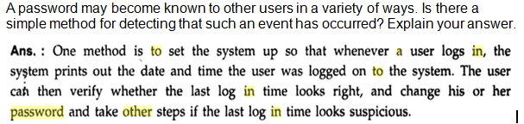
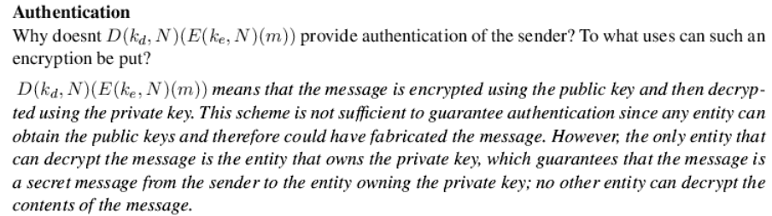
Possible Questions & Answers
Operating System Concepts

Slide 16
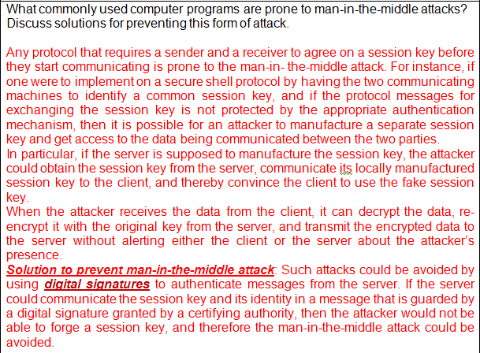
Operating System Concepts

Slide 17
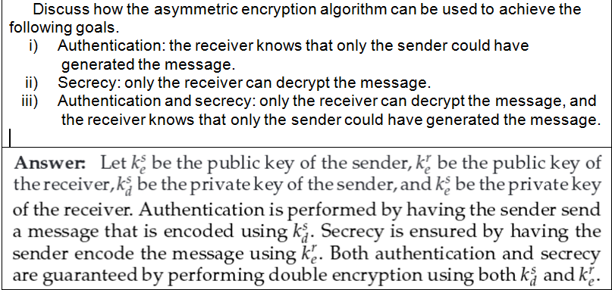
Possible Questions & Answers
What are two advantages of encrypting data stored in the computer system?
Answer: 1) Encrypted data are guarded by the operating system’s protection facilities, as well as a password that is needed to decrypt them. 2) Two keys are better than one when it comes to security.
Operating System Concepts

Slide 18
Possible Questions & Answers
Differentiate between threat and attack.
“A threat is a category of objects, persons, or other entities that represents a constant danger to an asset”.
“An attack is an act or event that exploits vulnerability”.
Main difference between threat and attack is a threat can be either intentional or unintentional where as an attack is intentional. Threat is a circumstance that has potential to cause loss or damage whereas attack is attempted to cause damage. Threat to the information system doesn’t mean information was altered or damaged but attack on the information system means there might be chance to alter, damage, or obtain information when attack was successful.
What do you mean by theft of service and denial of service?
Theft of service: 1) Application Level Attack; 2) Attacker Gains Increased Access To Restricted or Limited Resources; 3) Opportunistic Attack; 4) Typically does not result in system administration access. TOS means a violation that involves unauthorized use of resources. For example, an intruder (or intrusion program) may install a daemon on a system that acts as a file server.
Denial of Service: A denial of service (DoS) attack is an incident in which a user or organization is deprived of the services of a resource they would normally expect to have. In a distributed denial-of-service, large numbers of compromised systems (sometimes called a botnet) attack a single target.
Operating System Concepts

Slide 19
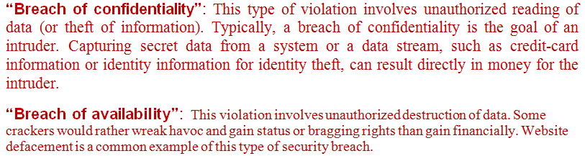
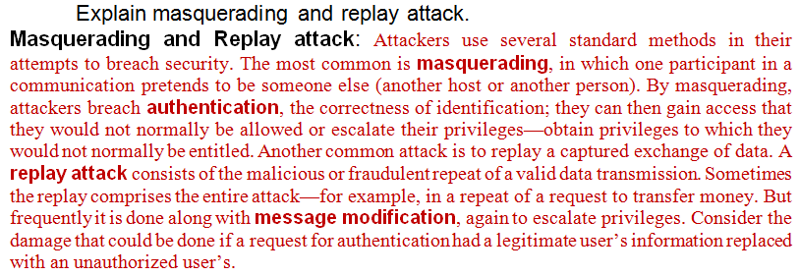
Possible Questions & Answers
Explain the term “breach of confidentiality” and “breach of availability”.
Operating System Concepts

Slide 20
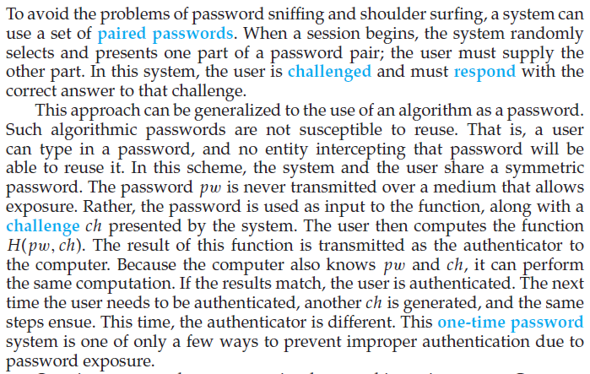
Possible Questions & Answers
Discuss how one-time password scheme is implemented
Operating System Concepts

Slide 21
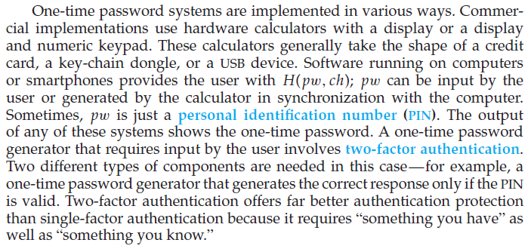
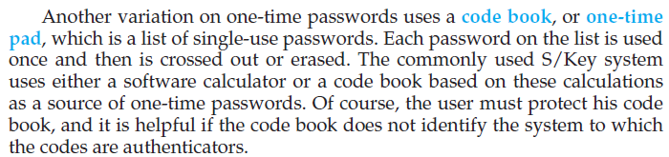
One-time password scheme
Operating System Concepts

Slide 22
https://searchsecurity.techtarget.com/definition/asymmetric-cryptography
Operating System Concepts

